Slide 1

CS2009 Design and Analysis of Algorithms
Course supervisor: anaum hamid

Slide 2
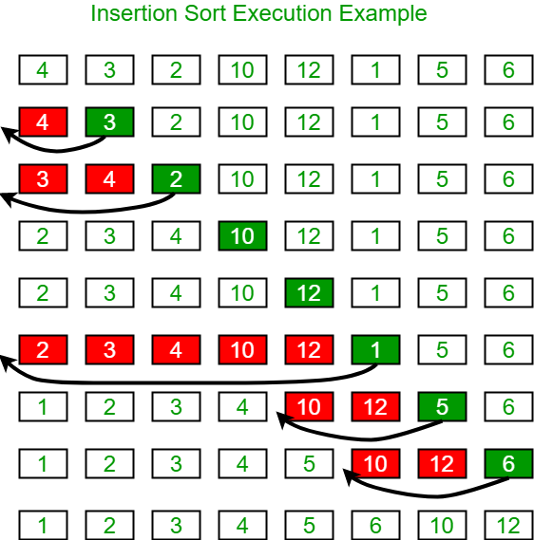
Insertion Sort

Slide 3
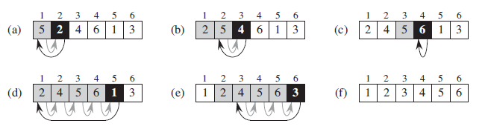
Insertion Sort

Slide 4
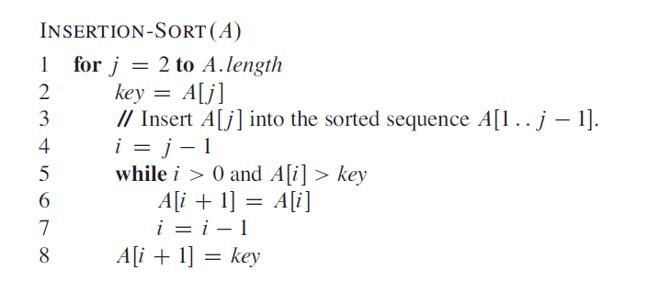
Insertion Sort

Slide 5
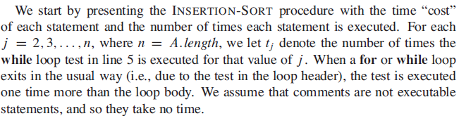
Insertion Sort

Slide 6
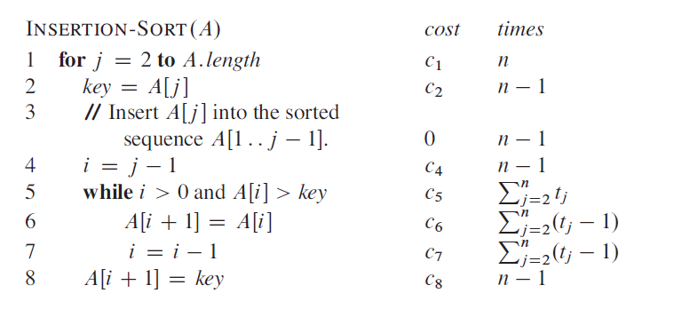
Insertion Sort

Slide 7
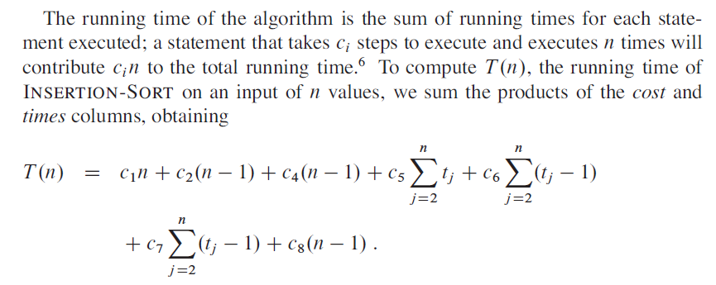
Insertion Sort

Slide 8
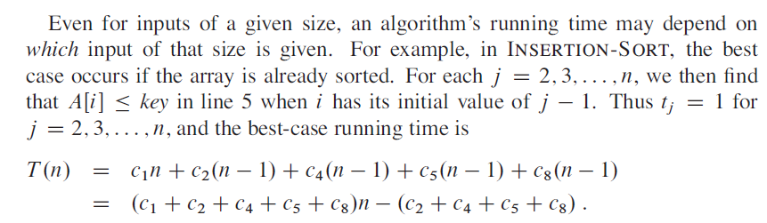
Insertion Sort
Best Case Time :

Slide 9

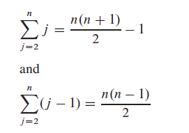
Insertion Sort
Worst Case Time :

Slide 10
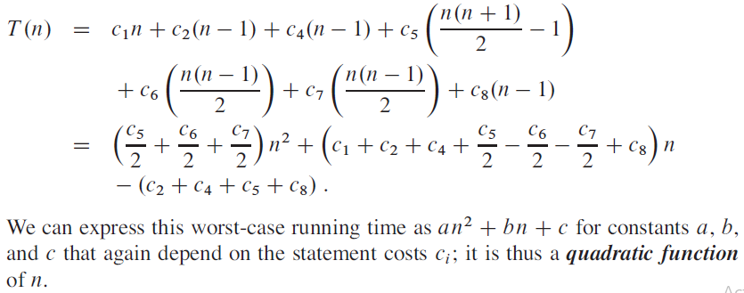
Insertion Sort
Worst Case Time :

Slide 11
Loop invariant
Loop Invariant:
Before understanding loop invariant of insertion sort, lets see what loop invariant is:
Loop invariant is the condition that remains true before and after each iteration of loop.
For example:
j = 9;
for (i=0 ; i<=9 ; i++)
j-- ;
Loop invariant : i + j = 9 (for every iteration)
Now we will prove this loop invariant for initialization, maintenance and termination.

Slide 12
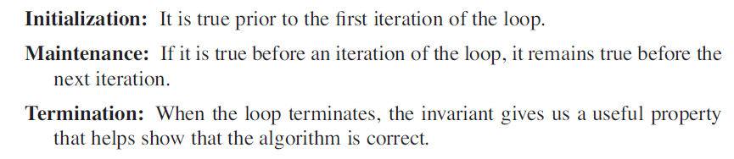
Loop Invariant

Slide 13
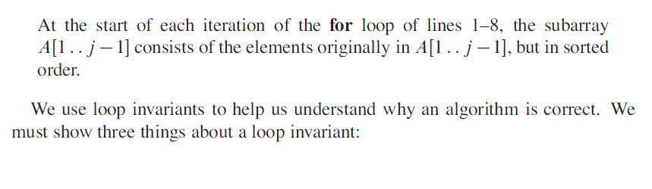
Loop invariant of Insertion Sort
Loop Invariant:

Slide 14
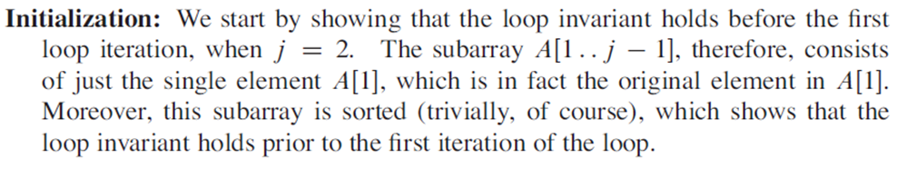
Insertion Sort

Slide 15
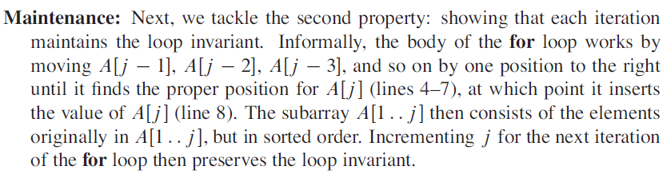
Insertion Sort

Slide 16
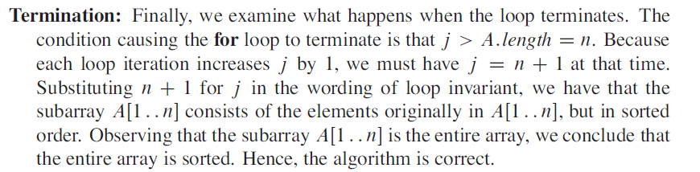
Insertion Sort

